Slide 1
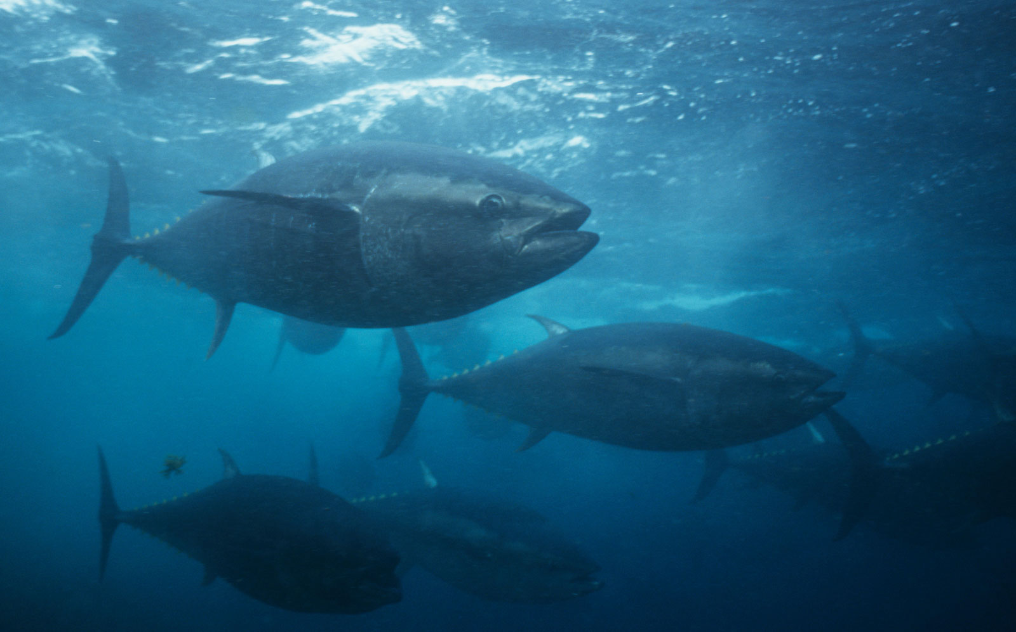
Tuna Fish
By Tuna Citci 4i

Slide 2
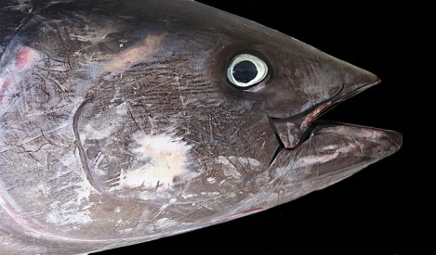
Where do they live
Tuna fish live in salty water, in the seas and oceans. They live in a place called the mixed layer .The mixed layer is cold water mixed with warm water.
Home

Slide 3
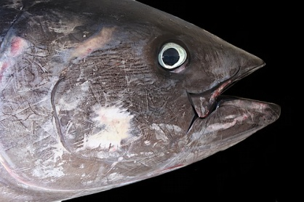
What do they eat?
They eat smaller fish about 1.5 inches to 6 inches. Tunas also eat squid, shellfish and a variety of planktonic organisms.
The Tuna fish travel through incredible distances to feed, such as from American Coasts of the Atlantic Ocean to Europe Coasts.
I'm so tired let’s take a break

Slide 4
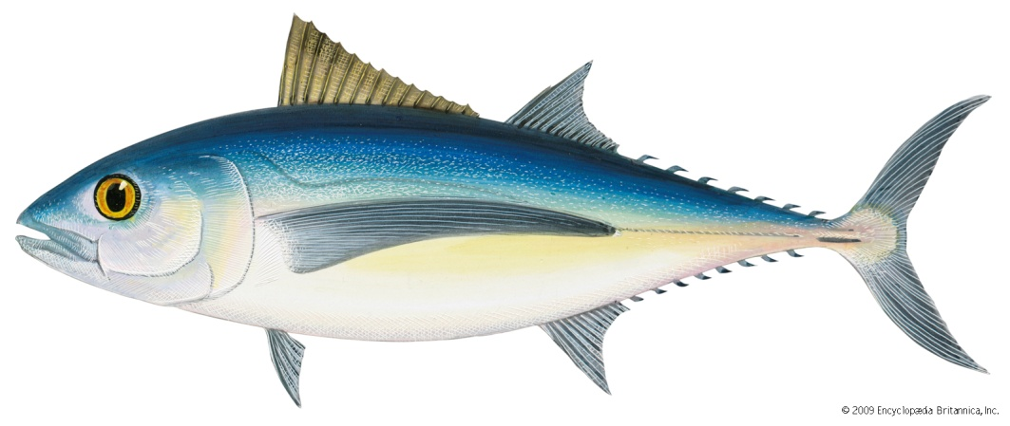
Facts about tuna fish
The seven species of Tunas are
Northern Bluefin Tuna
Albacore
Yellowfin Tuna
Southern Bluefin Tuna
Bigeye Tuna
Blackfin Tuna and
Longtail Tuna
These different species range from moderate to very large in size.
The giant of the group is the Northern Bluefin Tuna, which grows to a maximum length and weight of about 4.3 metres and 800 kg.
The Yellowfin Tuna reaches a maximum weight of about 180 kg.
The Albacore grows to about 36 kg.

Slide 5
Thank you for listening
Bye for now

